Slide 1

WELCOME MESSAGE
WINDOWS SERVER ADMINISTRATION
INSTRUCTOR: VALERY NYANDJA CHUIMI
I’M CERTIFIED RHCSA & AWS SOLUTION ARCHITEC
CLOUD ENGINEER AT HUB INTERNATIONAL

Slide 2
Welcome to windows server administration
Brought by: unixcloudtrainings.
About this course:
At the end of this course you will be able to Install and configure a Domain Controller, Active Directory, DNS, WebServer (IIS), Group Policy, WSUS, get your IT dream job and more…….
Website: unixcloudtrainings.com
E-mail: unixcloudtraining73@gmail.com
Contact: +1(412)-808-4437
By: VALERY NYANDJA

Slide 3
MODULE I- What is WINDOWS?
Windows: is a collection of programs as an operating system that controls a pc ( personal computer).
DIFFERENT VERSIONS OF WINDOWS
Link: https://en.wikipedia.org/wiki/List_of_Microsoft_Windows_versions

Slide 4
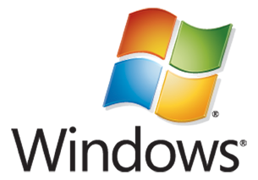
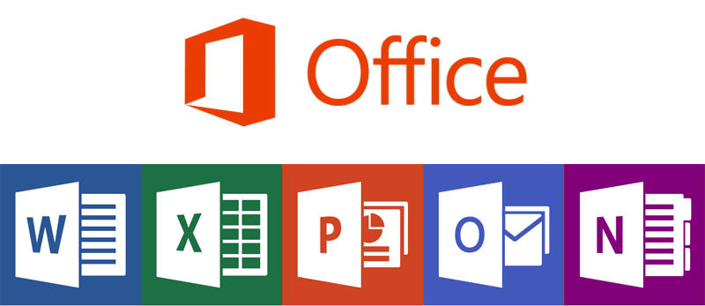
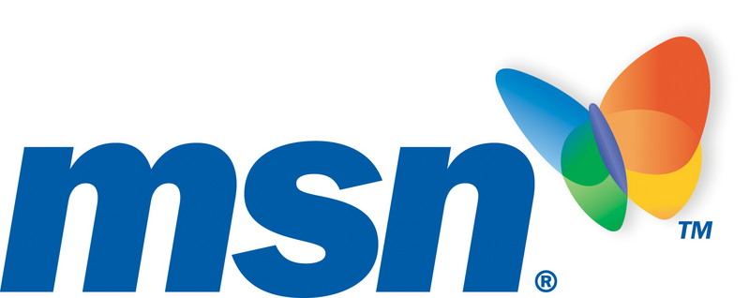
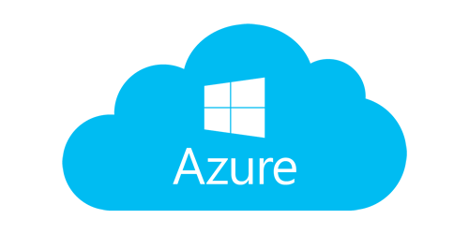
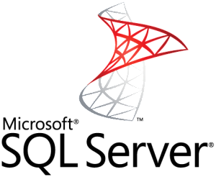
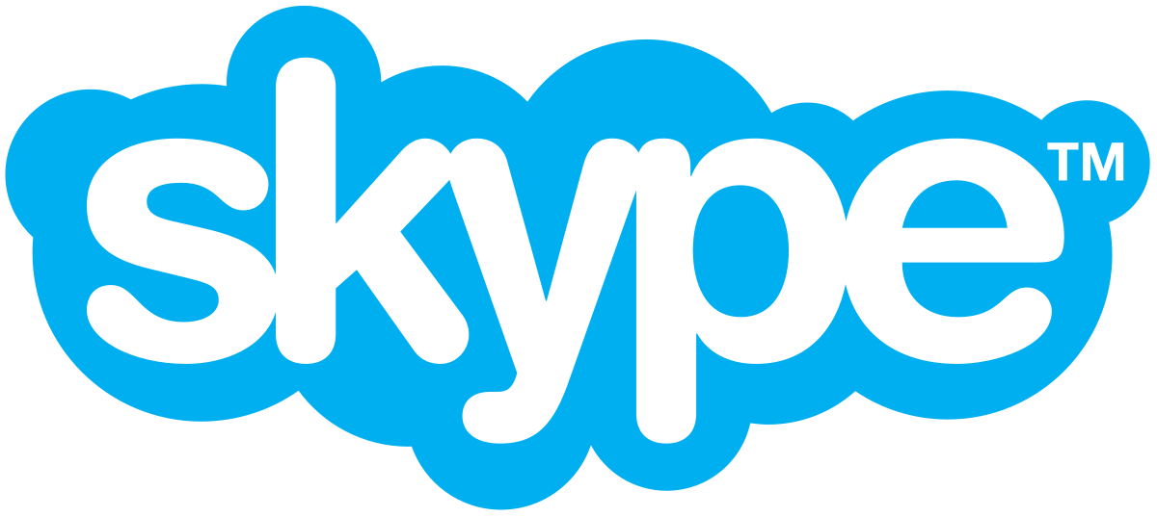
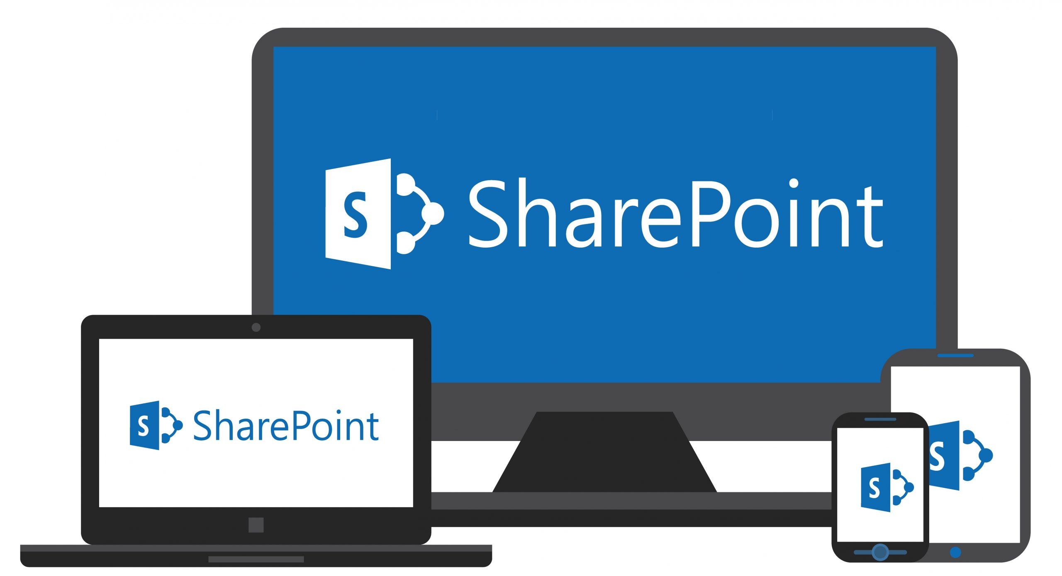
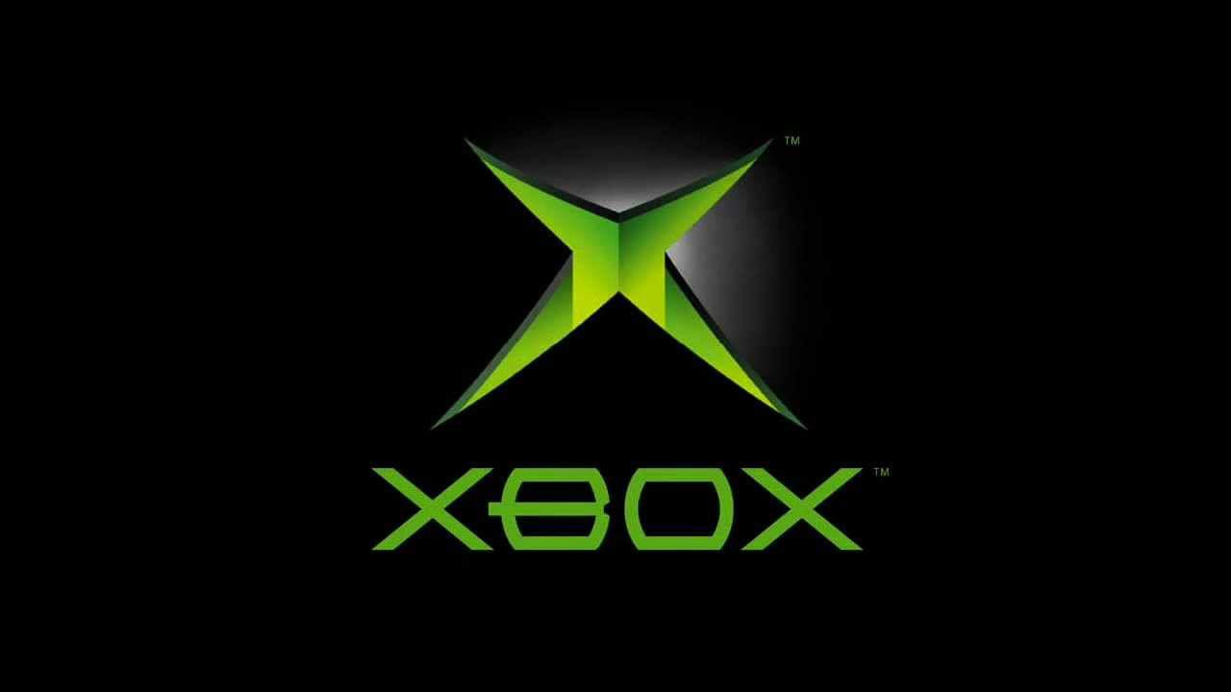
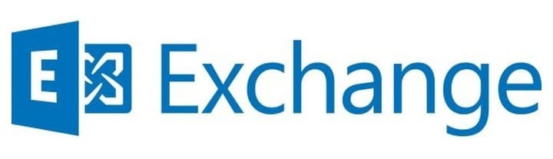
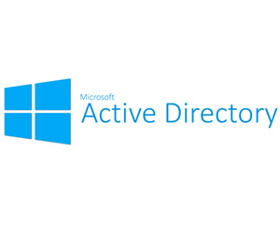
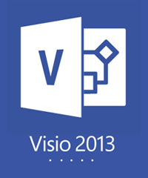
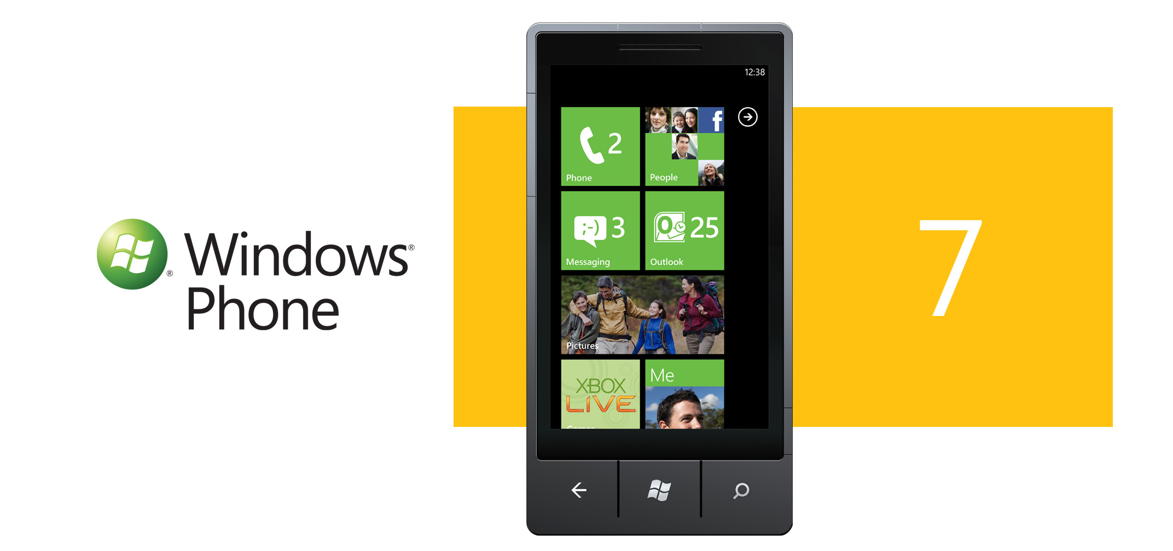
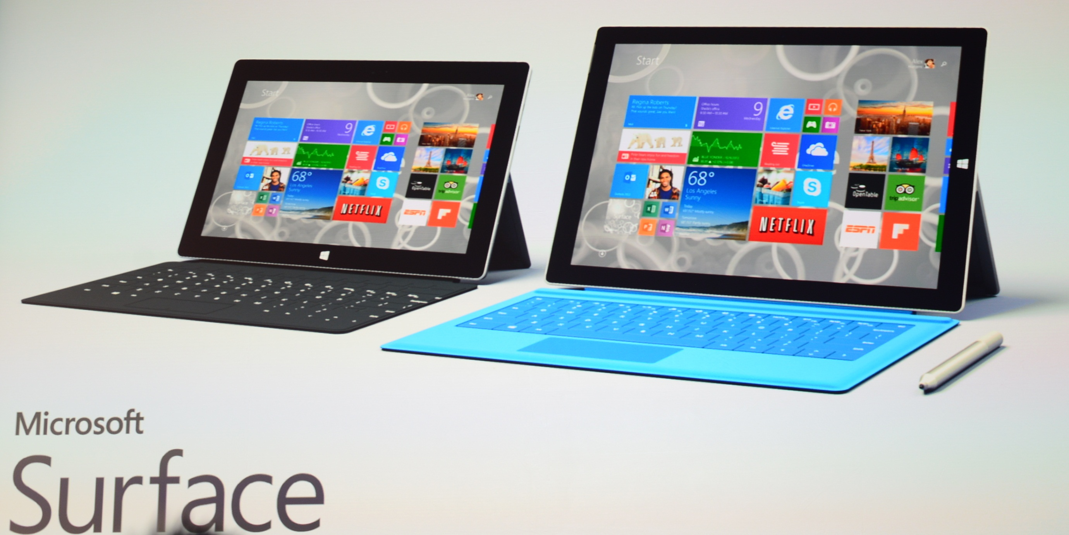
MICROSOFT PRODUCTS

Slide 5
WINDOWS BACKGROUD
Windows is owned by………………….
Microsoft is co-funded by and PAUL ALLEN on April 4, 1975.

Slide 6
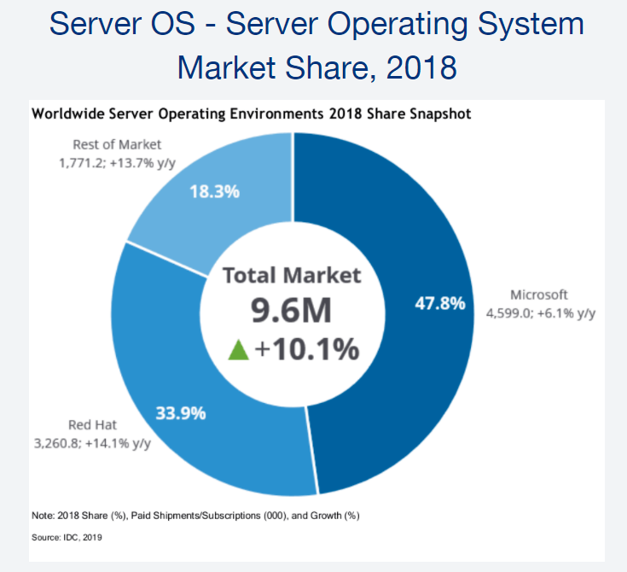

Slide 7
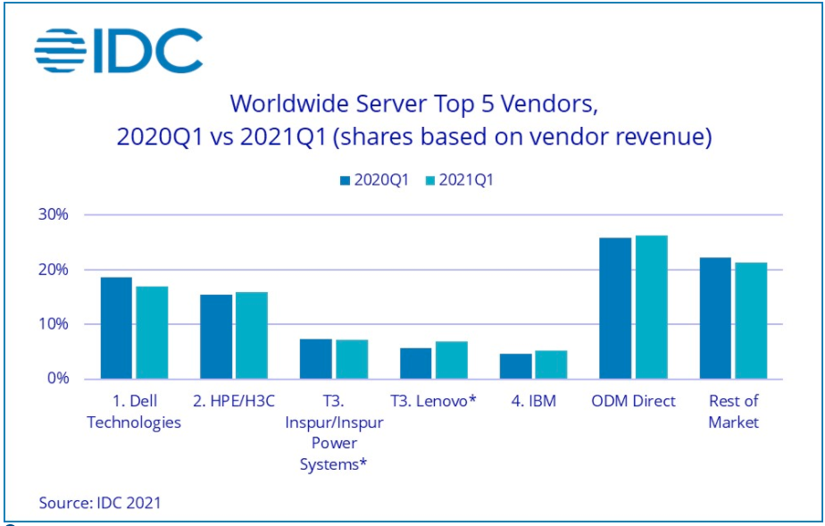

Slide 8
Windows vs Linux vs Mac

Slide 9
Windows vs Linux vs Mac

Slide 10
Windows vs Linux vs Mac

Slide 11
MODULE 2- SITTING UP THE LAB
Steps to setup the lab
What is a virtual environment or virtual machine.
Download and installing oracle VirtualBox.
Creating first virtual machine.

Slide 12
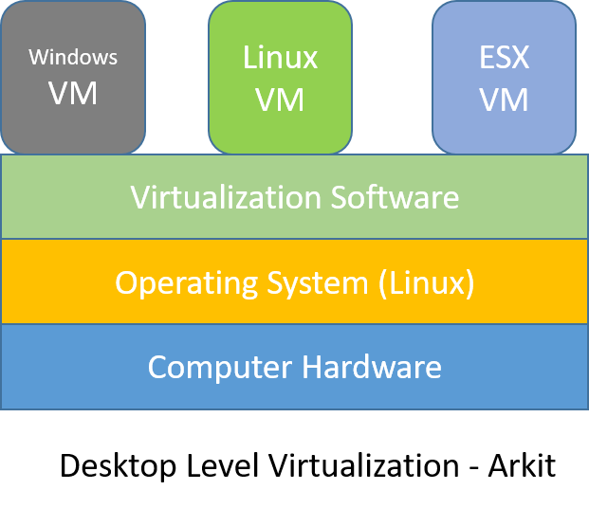
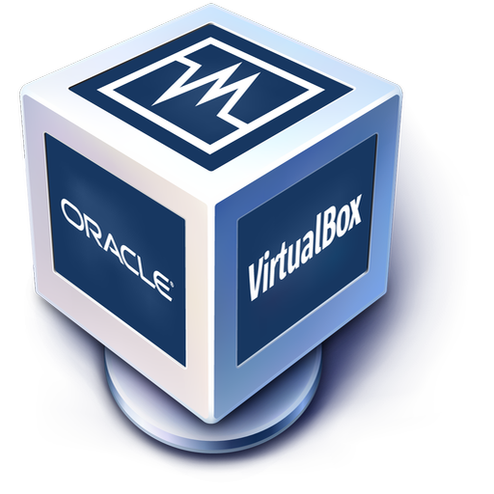
What is oracle virtual box?
Oracle VM VirtualBox is a free, open source, cross-platform application for creating, managing and running virtual machines (VMs).
Virtual machines allow you to run an operating system in an app window on your desktop that behaves like a full, separate computer. You can use them play around with different operating systems, run software your main operating system can't, and try out apps in a safe, sandboxed environment.
Oracle VirtualBox enables you to set up one or more virtual machines (VMs) on a single physical machine, and use them simultaneously, along with the actual machine. Each virtual machine can execute its own operating system, including versions of Microsoft Windows, Linux, BSD, and MS-DOS. You can install and run as many virtual machines as you like – the only practical limits are disk space and memory.

Slide 13
VirtualBox installation
This is the site for downloading VirtualBox: www.virtualbox.org
create our fist virtual machine.

Slide 14
Creating a New Virtual Machine in VirtualBox
To create a new virtual machine, you need to start VirtualBox. On the host where you installed Oracle VDI and VirtualBox, select the Applications menu on the desktop, then the System Tools menu, and then Oracle VM VirtualBox. Alternatively, you can run the VirtualBox command in a terminal. The Oracle VM VirtualBox Manager is displayed as shown in Figure 6.4.

Slide 15
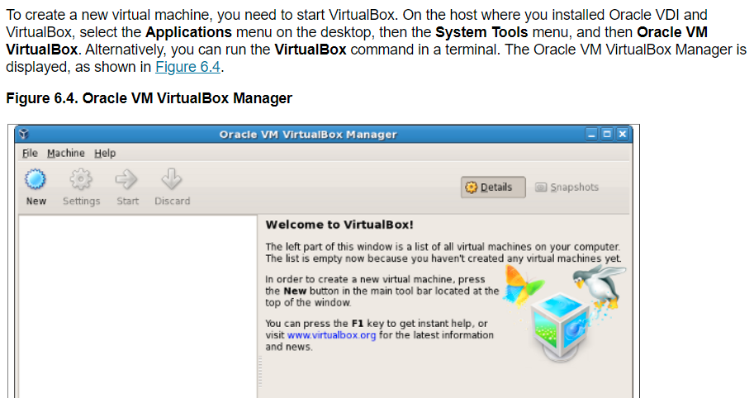

Slide 16
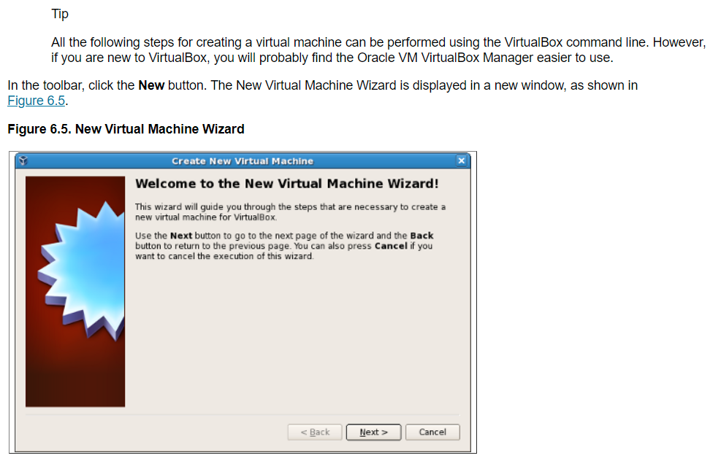

Slide 17
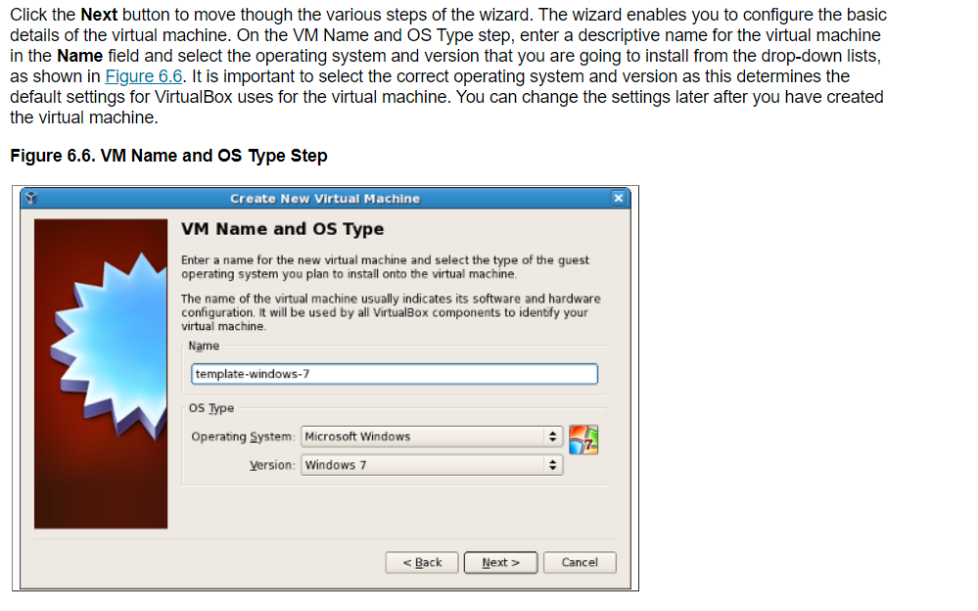

Slide 18
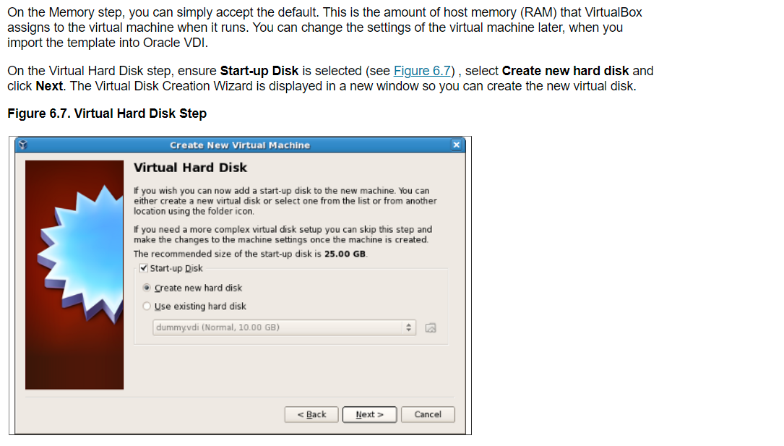

Slide 19
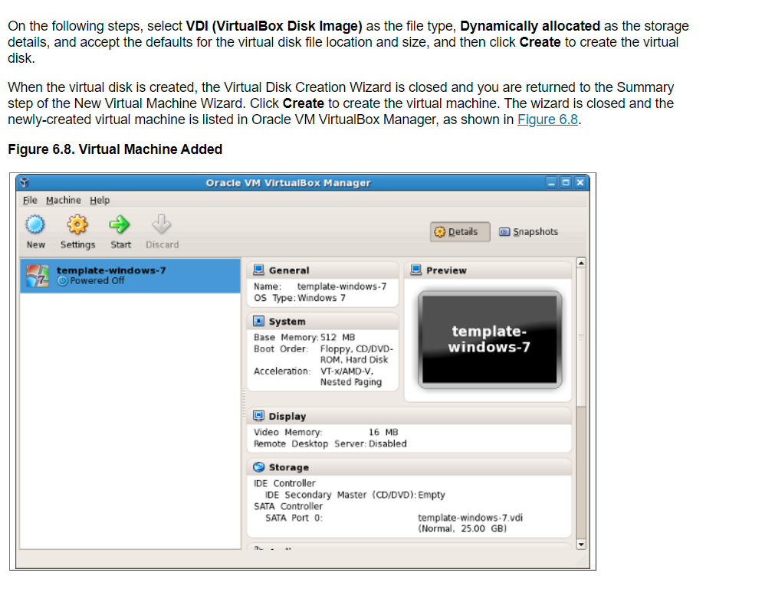

Slide 20
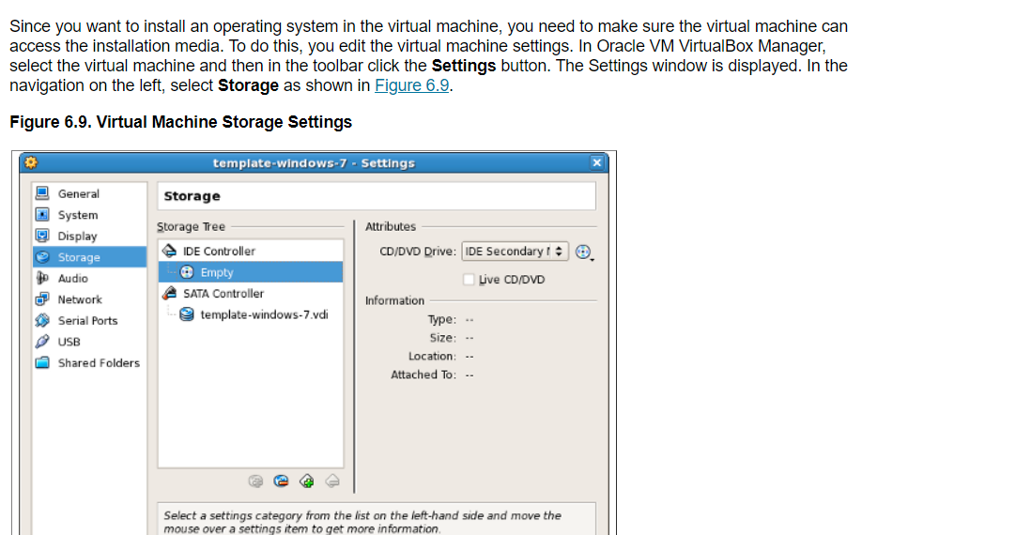

Slide 21
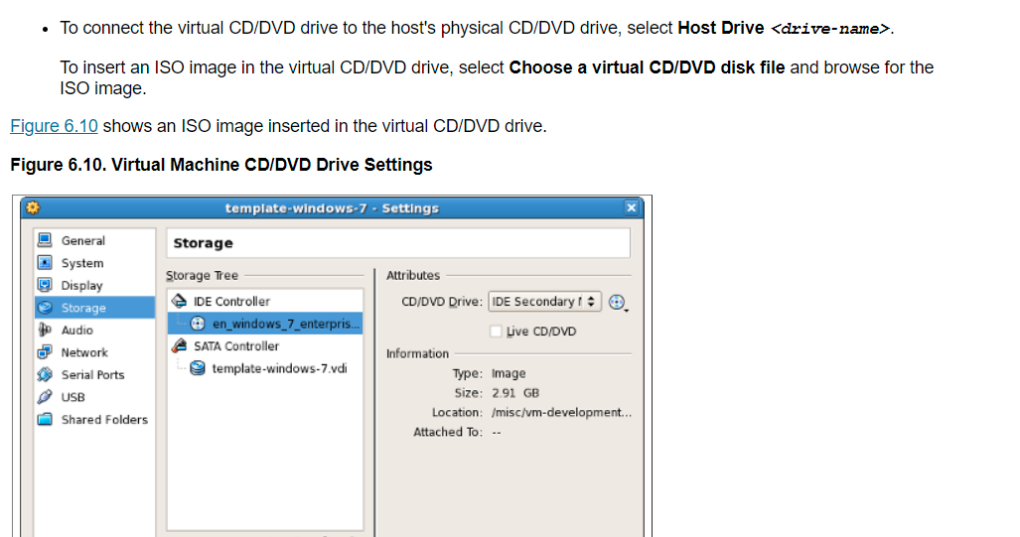

Slide 22
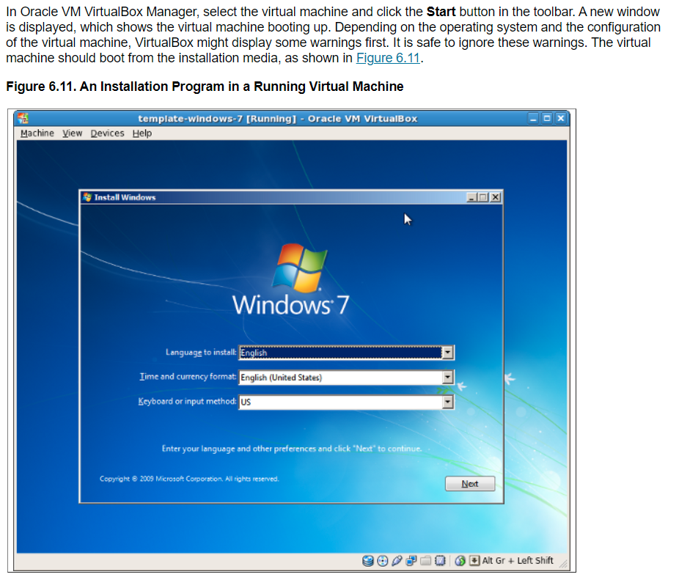

Slide 23
quiz
1- What’s Microsoft windows?
Home structure windows?
Operating system
Hardware
Peripherals
2- Why do we need and operating system?
Without operating system there is no communication with hardware.
Without operating system there is no communication with users.
Without operating system there is no operating between hardware and users.
Without operating system there is no communication with applications.
3- what are different versions of windows?
Windows 2003
Windows 2012
Windows server 2016
Windows 7 & XP
All above

Slide 24
Quiz (HOMEWORK)
4- Microsoft was funded by Bill Gates and Paul Allen on?
April 4th , 1975
April 4th , 1976
April 5th , 1975
May 6th , 1976
5- Which ones are the products of Microsoft?
PlayStation
Linux
Chrome Web Browser
None of the above
6- What is common on Windows, Mac and Linux.
They are all hardware.
They are all personal computers.
All of them are operating system.
All of them are paid software.
7- Which operating system is more vulnerable to viruses.
a) Linux ; b) Windows ; c) Mac ; d) VMware

